Slide 1


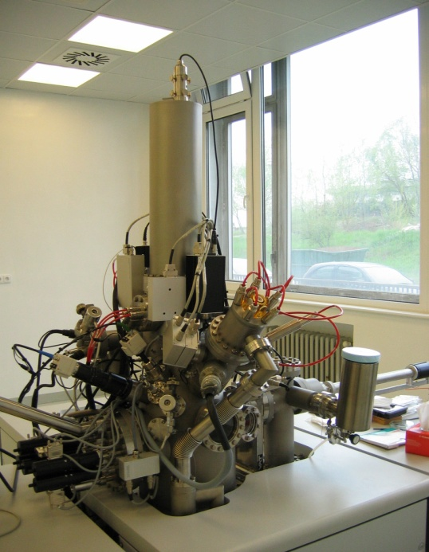
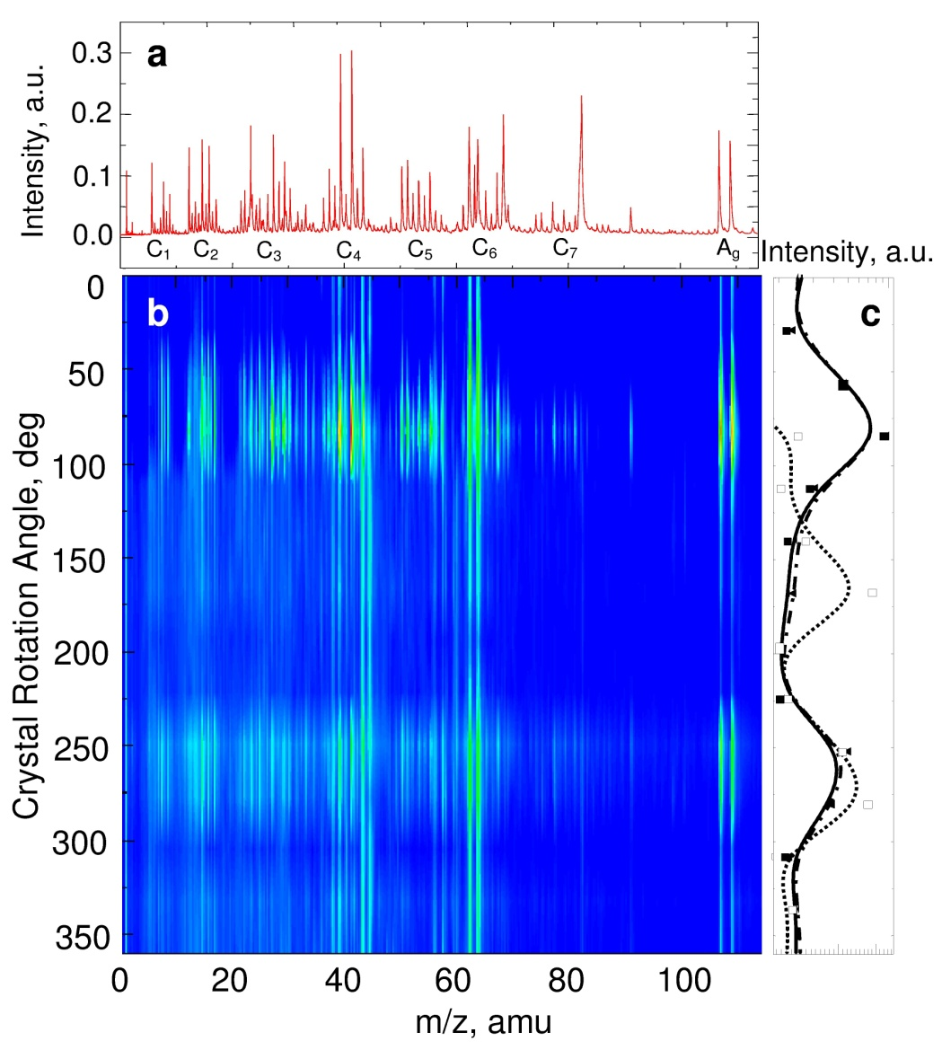
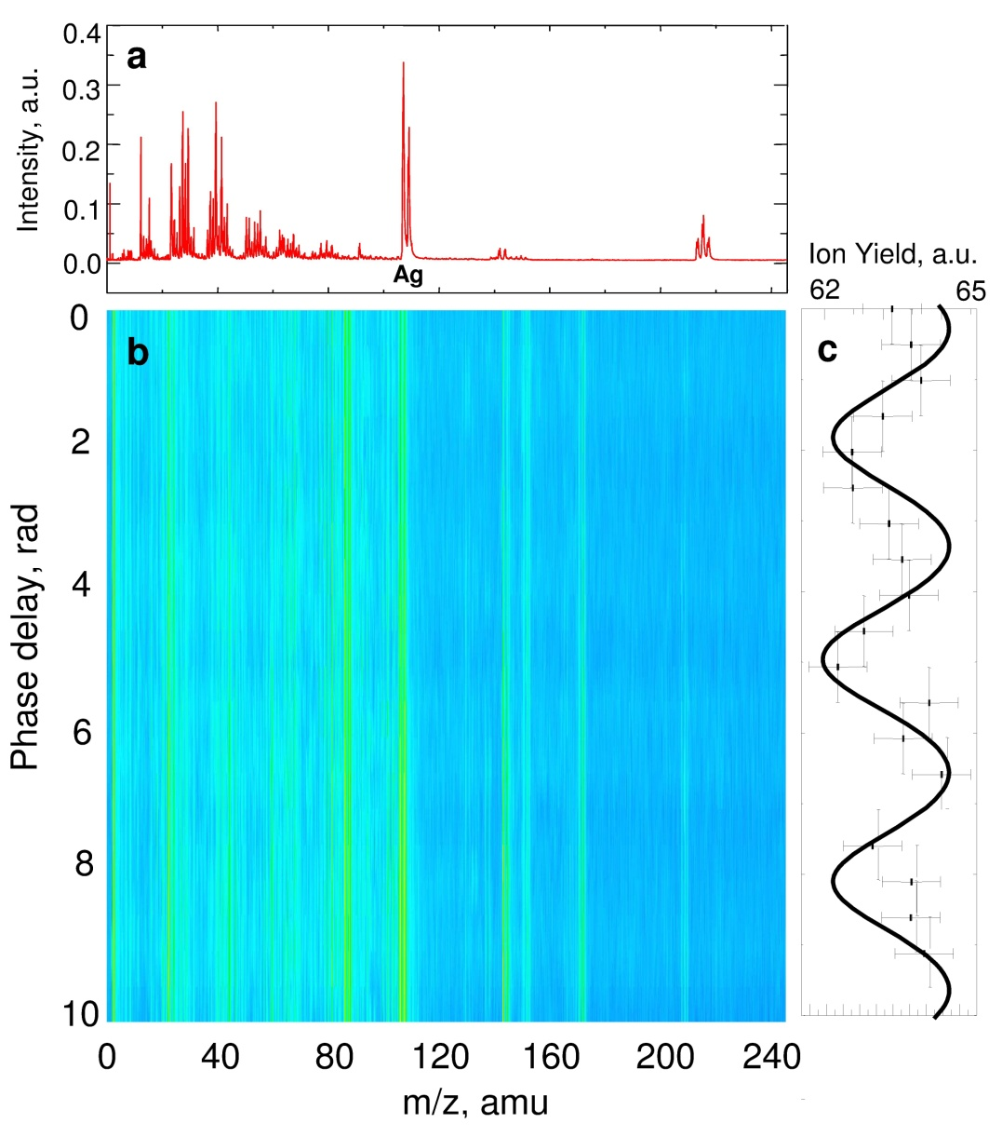

Two-color wavemixing in Secondary Ion Mass Spectrometry
DUSAN LORENC, MONIKA JERIGOVA, DUSAN VELIC
International Laser Center, Ilkovicova 3, 842 15 Bratislava, Slovak Republic, e-mail: dusan.lorenc@ilc.sk
Department of Physical and Theoretical Chemistry, Faculty of Natural Sciences, Comenius University, Ilkovicova 6, 842 15 Bratislava, Slovak Republic
Abstract
An alternative method for laser post-ionization in secondary ion mass spectrometry is introduced. By mixing a fundamental laser field with the intensity of 1×10¹⁵ W/cm² with its second harmonic component, a control is attained over a yield of the specific ion. A significant alternation of ionization, as increase and decrease of ion intensity, is demonstrated for both bulk silver surface and silver nanoparticles on the surface. The results are explained in terms of tunneling ionization with symmetry broken fields. The novel method opens additional degree of freedom for the control over the ion yield in SIMS analysis.
Compressor
1 mJ, 50 Hz, 100 fs
TOF
Experimental
The time-of-flight SIMS (ION-TOF, IV) was employed. The sample surface was bombarded with 25 keV Bi⁺ primary ions with the pulse duration of 1 μs and the repetition rate of 50 Hz. A Cr:forsterite fs IR master oscillator power amplifier, that is based upon a three-stage amplifier (100 fs, 4.5 mJ, 1240 nm, photon energy ~ 1eV), was used as the laser source for post-ionization. The laser system was operated at a repetition rate of 50 Hz and a set of delay generators (Stanford Research Systems, DG535) was used to synchronize the laser with the SIMS. Real-time laser pulse diagnostics was performed using the GRENOUILLE FROG (LLC, Swamp Optics) and the QuickFrog software.
Multipass
Regen
LMIG
Stretcher
Master Oscillator
Sample
Sync
SIMS spectrum of silver nanoparticles (a) and silver (b) surfaces
Cr:Forsterite laser system ION TOF SIMS IV
silver surface is characterized by the Ag doublet corresponding to the ¹⁰⁷Ag and ¹⁰⁹Ag isotopes, multiple organic fragments, and background contaminants Na, K
organic fragments were identified mostly in the form of C_{x}H_{y}N_{z}O⁺ (x=1-5, y=0-11, z=0-3, w=0-2), originating from the background contamination and eventual oxidation of the surface
in the spectrum of silver nanoparticles, oleic acid fragments were additionally identified in the form of C_{x}H_{y}⁺ (x=1-7, y=0-11)
Post-ionization spectra Composite field of ω and 2ω
E₁, E₂ - amplitudes for the ω and 2ω field
- phase
θ - additional phase shift between the fields
The single-color post-ionization spectra of silver nanoparticles (a). The two-color post-ionization, three dimensional spectra of silver nanoparticles (b) as a function of the SHG crystal angular detuning. Angular tunability of the relative ion yield of Ag¹⁰⁷ (solid squares, solid curve) and Ag¹⁰⁹ isotopes (solid triangles, dash-doted curve) and the C₂H₄O₂ ion (hollow squares, dotted curve) (c). The lines are only to guide the eye.
The single-color post-ionization spectra of silver surfaces (a). The two-color post-ionization, three dimensional spectra of silver surface (b) as a function of the phase between the ω and 2ω fields. Total ion yield as a function of the phase delay between the ω and 2ω fields (c). Experimental data (squares) are overlapped by the ion yield (solid line) calculated for I₁ = 10¹⁵ W/cm², I₂ = 10¹³ W/cm².
Conclusions
The method of wave-mixing was applied in the laser post-ionization SIMS analysis. By mixing the fundamental laser field of the femtosecond laser with its second harmonic generation frequency, the control over the ion yields was demonstrated. The yield of atoms and molecular fragments was thereby enhanced/suppressed by a factor of up to 20. The influence of the symmetry broken field on the ion yield was confirmed by angular turning as well as by revealing the phase dependence of the wave-mixing process. The method therefore opens additional degree of freedom for the control over the ion yield in SIMS analysis.

