Slide 1
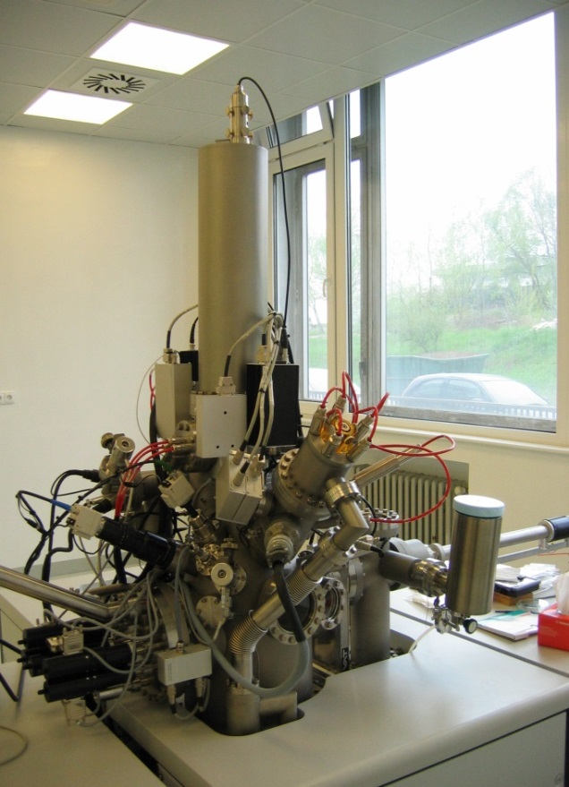

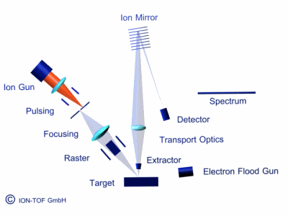
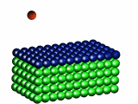
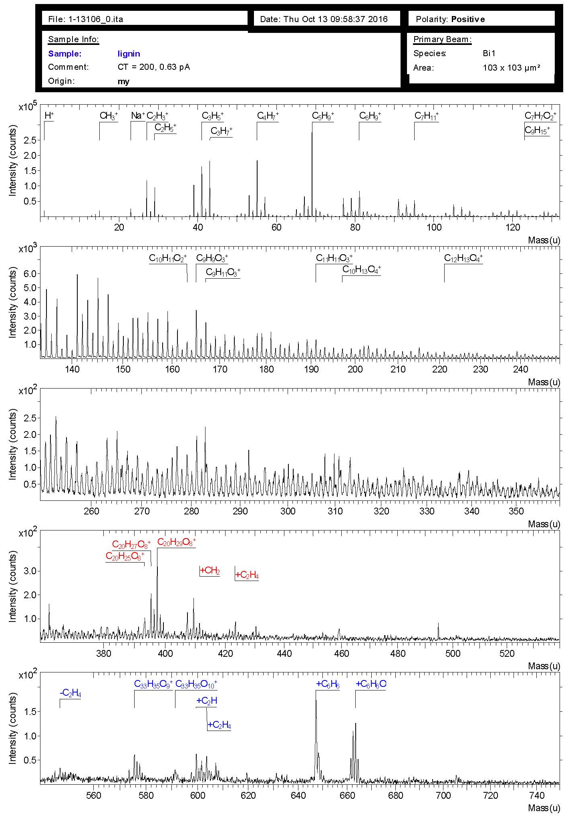
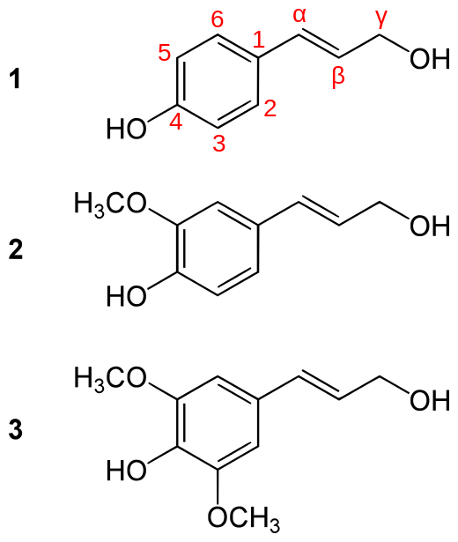
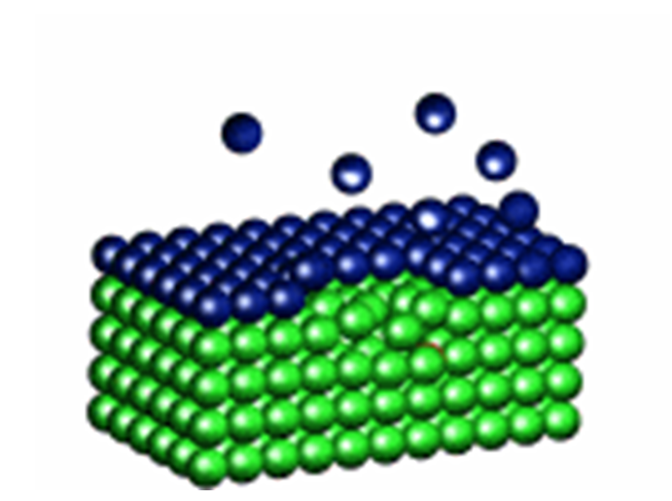
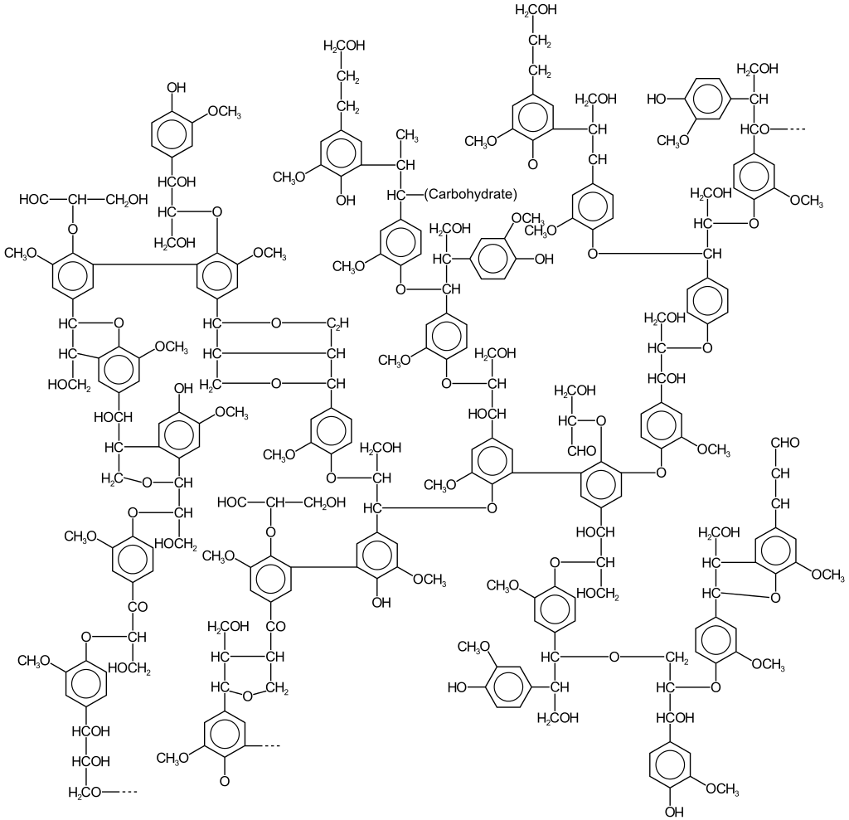

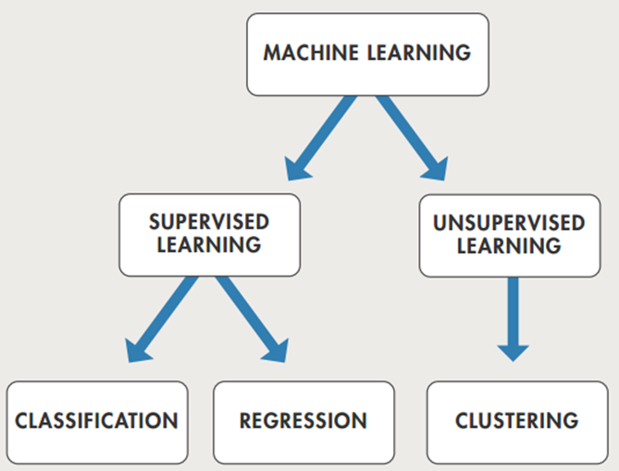
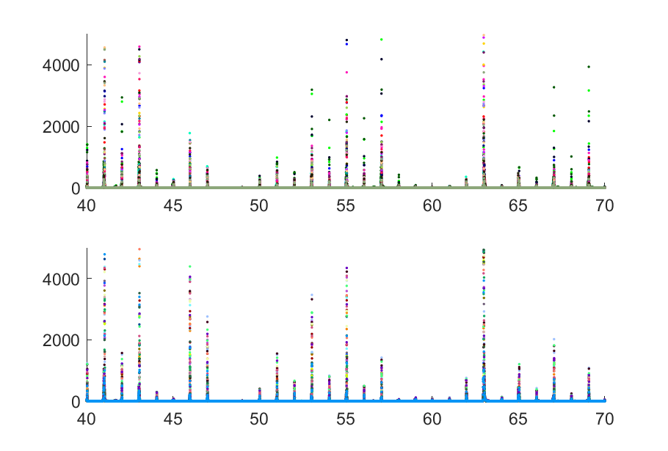
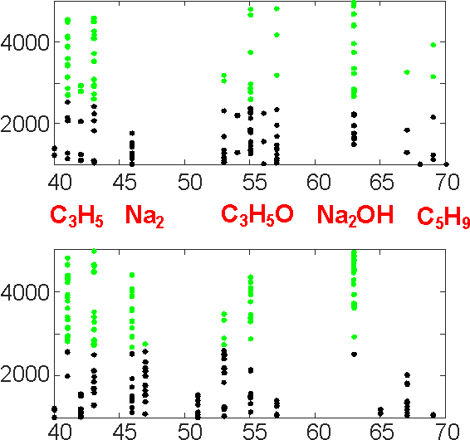
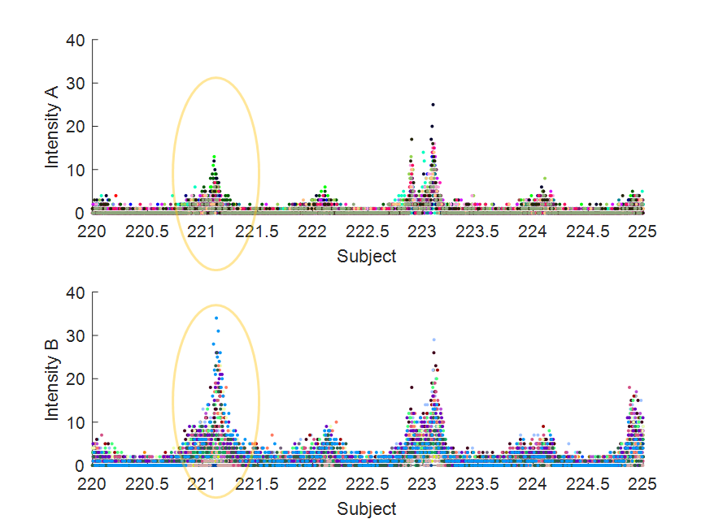
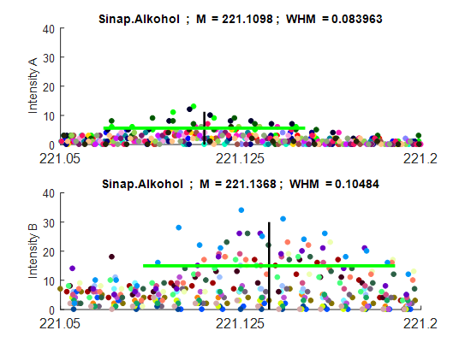

SIMS DATA ANALYSIS of LIGNIN COMPOSITES
Monika Jerigová¹, Vojtech Szöcs¹, Dušan Lorenc¹ and Dušan Velič^{1,2}
¹ International Laser Centre, Ilkovicova 3, Bratislava 84104, Slovakia, web.mlc.sk/duvel
² Faculty of Nat.Sciences, Comenius University, Ilkovicova 6, Bratislava 84104, Slovakia
Lignin has the potential to be an important source of aromatic chemicals for the chemical industry. Knowing its structure is of primary interest. Our aim was to study the presence of three types of lingnin constituents (p-coumaryl alcohol, coniferyl alcohol, and syringyl alcohol) in different chemical modifications [1]. The SIMS method is a highly sensitive spectral method for obtaining masses and subsequent identification of individual molecular components of the measured object. For objective evaluation of the measurement, it is necessary to do several dozen scans in a wide range of weights followed by data pre-processing to determine the suitable region of interest. In order to optimize computer resources and computation time, traditional analytical methods (e.g. peak fitting) can be combined with artificial intelligence and machine learning (ML) algorithms [2,3]. The most suitable methods seem to be those of unsupervised learning branch of ML, namely clustering. These methods allow us to choose the proper data range (and thus substantially reduce the actual amount of data). The later nonlinear fit in prepared data range allows us to make a more precise estimate of the corresponding component mass weight.
Experiment : SIMS
Primary ions
Ar⁺, Ga⁺, SF₅⁺, Au_{n}⁺, Bi_{n}⁺ (n= 1-7)
C60⁺
Secondary ions
(sample surface)
Seecondary ions
(lower layers)
Time of Flight
E_{k} = 1/2 mv² = eU
t = L/v = L (m/2eU)^{1/2}
Mass Spectrum
I = f(m/z)
Lignin : (C₃₁H₃₄N₁₁)_{n} + phenol
(1) paracoumaryl alcohol
M ≈ 162.1
(2) coniferyl alcohol
M ≈ 192.1
(3) sinapyl alcohol
M ≈ 221.1
By striking the high energy primary ion, secondary ions are drawn from the surface of the sample. Ions are analyzed according their time of flight.
ML – ANALYSIS of SIMS Spectra
RESULTS
Create a "good" data set
(local maxima)
2. Adaptation of ML program k-means
(fast clustering for large files)
The algorithm starts initial
estimate of clusters,
repeatedly
trying to move them to areas,
which are "dense" in the data, and the "cost function" is MINIMIZED.
The algorithm terminates when cluster class values remain unchanged between two consecutive iterations
3. Global fit around the peak of step 2
Intenzity A
Analysis of 2x20 spectra
in range 1 – 400
A (1-20) : pure phenol
B (21-40): phenol with
80% lignin replacement
Intenzity B
k-Means vs. Global fit
Intenzity A
k-Means | Identified | Glob.fit
41,05 | C₃H₅ | 41.042
45,98 | Na₂ | 45,982
57,07 | C₃H₅O | 57,073
62,99 | Na₂OH | 62,992
69,08 | C₅H₉ | 69.077
Intenzity B
References
[1] F. G. Calvo-Flores et al., Lignin and Lignans as Renewable Raw Materials, John Wiley & Sons, 2015;
O.Faruk, M.Sain, Lignin in Polymer Composites, Elsevier, 2016.
[2] C.Zhou et al, BMC Bioinformatics 2008, 9, 325
[3] M. Gastegge et al, Chem. Sci., 2017, 8, 6924
Region of sinapyl-alcohol : M ≈ 221.137
Acknowledgements
The research is supported by the Grant Agency of the Slovak Republic,
project APVV-15-0201.

